Slide 1

Personal Statement
Prof Paul E. Richardson
Summer Coastal Research Experience

Slide 2

Personal Statement
This talk will walk you though the things you will need to know to write a good personal statement. Please ask questions when they arise, this is meant to be a learning experience so be active in the presentation. As always please talk to your mentor or me if you have questions, that is one of the things we are trying to do to prepare you for your future.

Slide 3

Learn to sell yourself
Learn how to talk about yourself

Slide 4

The personal statement, your opportunity to sell yourself in the application process, generally falls into one of two categories
The general, comprehensive personal statement
This allows you maximum freedom in terms of what you write and is the type of statement often prepared for standard medical or law school application forms.
The response to very specific questions:
Often, business and graduate school applications ask specific questions, and your statement should respond specifically to the question being asked. Some business school applications favor multiple essays, typically asking for responses to three or more questions

Slide 5

Questions to ask yourself before you write:
Before you start to write consider these

Slide 6

Questions to ask yourself before you write:
What's special, unique, distinctive, and/or impressive about you or your life story?
What details of your life (personal or family problems, history, people or events that have shaped you or influenced your goals) might help the committee better understand you or help set you apart from other applicants?

Slide 7

Questions to ask yourself before you write:
When did you become interested in this field and what have you learned about it (and about yourself) that has further stimulated your interest and reinforced your conviction that you are well suited to this field?
What insights have you gained? How have you learned about this field—through classes, readings, seminars, work or other experiences, or conversations with people already in the field?

Slide 8

Questions to ask yourself before you write:
If you have worked a lot during your college years, what have you learned (leadership or managerial skills, for example), and how has that work contributed to your growth?
Are there any gaps or discrepancies in your academic record that you should explain (great grades but mediocre LSAT or GRE scores, for example, or a distinct upward pattern to your GPA if it was only average in the beginning)?

Slide 9

Questions to ask yourself before you write:
Have you had to overcome any unusual obstacles or hardships (for example, economic, familial, or physical) in your life?
What personal characteristics (for example, integrity, compassion, and/or persistence) do you possess that would improve your prospects for success in the field or profession? Is there a way to demonstrate or document that you have these characteristics?

Slide 10

Questions to ask yourself before you write:
What skills (for example, leadership, communicative, analytical) do you possess?
Why might you be a stronger candidate for graduate school—and more successful and effective in the profession or field than other applicants?
What are the most compelling reasons you can give for the admissions committee to be interested in you?

Slide 11

Questions to ask yourself before you write:
What are your career goals?

Slide 12

Consider this advice while you write

Slide 13

While you write consider this advice:
Concentrate on your opening paragraph
The lead or opening paragraph is generally the most important. It is here that you grab the reader's attention or lose it. This paragraph becomes the framework for the rest of the statement.
Make it personal
Talk about yourself and the experiences you have encountered that would make you an ideal candidate. Eliminate their concern about you doing the job and prove to them you are a safe bet.

Slide 14

While you write consider this advice:
Find an angle
If you're like most people, your life story lacks drama, so figuring out a way to make it interesting becomes the big challenge. Finding an angle or a "hook" is vital. Keep it truthful, no tall tales!
Tell a story
Think in terms of showing or demonstrating through concrete experience. One of the worst things you can do is to bore the admissions committee. If your statement is fresh, lively, and different, you'll be putting yourself ahead of the pack. If you distinguish yourself through your story, you will make yourself memorable.

Slide 15

While you write consider this advice:
Answer the questions that are asked
Be specific to the position you are writing to, do not reuse material. Personalize each letter to the application
Do some research, if needed
If a school wants to know why you're applying to it rather than another school, do some research to find out what sets your choice apart from other universities or programs. If the school setting would provide an important geographical or cultural change for you, this might be a factor to mention.

Slide 16

While you write consider this advice:
Tell what you know
The bulk of your essay might detail your interest and experience in your particular field, as well as some of your knowledge of the field. Too many people graduate with little or no knowledge of the nuts and bolts of the profession or field they hope to enter. Be as specific as you can in relating what you know about the field and use the language professionals use in conveying this information. Refer to experiences (work, research, etc.), classes, conversations with people in the field, books you've read, seminars you've attended, or any other source of specific information about the career you want and why you're suited to it. Since you will have to select what you include in your statement, the choices you make are often an indication of your judgment.

Slide 17

While you write consider this advice:
Write well and correctly
Be meticulous. Type and proofread your essay very carefully. Many admissions officers say that good written skills and command of correct use of language are important to them as they read these statements. Express yourself clearly and concisely. Adhere to stated word limits.
Avoid clichés
A medical school applicant who writes that he is good at science and wants to help other people is not exactly expressing an original thought. Stay away from often-repeated or tired statements.

Slide 18
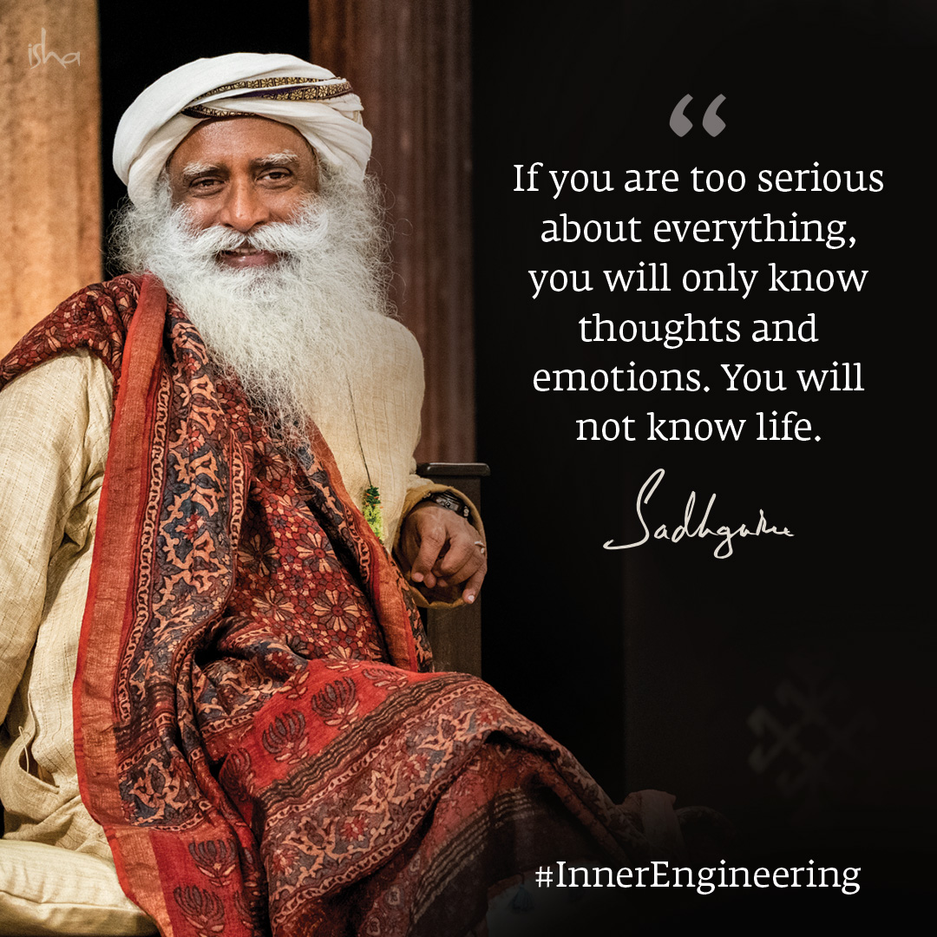
While you write consider this advice:
Not every essay needs to be serious or profound.
You can probably imagine how much drama college admission reads. A little levity goes a long way. If you have a sense of humor, use it! Also, if you are discussing a heavy topic, it may help to find places in your essay for some relief. A mature essay is one that can balance a spectrum of emotions.

Slide 19


Slide 20

This is your letter, you are the main character:
Make it about you
The purpose of this is to allow the reader to have a glimpse of you. Let the reader know the true version of you and the uniqueness that is you. Don’t oversell yourself, just be true to yourself.
Don’t get to caught up with what others have written
Looking at examples is fine, but this needs to be something that you write about yourself. Be original and only speak the truth. You will do fine, just don’t over do it.

Slide 21

Spelling and grammar
Relevancy
Specificity
Sentence structure
Passive voice
Clear phrasing
Simple, easy-to-understand language

Slide 22


Thank you
Dr Paul E. Richardson
prichar@coastal.edu
https://professorrichardsonresearch.com/

