Slide 1

Cover Letter
Prof Paul E. Richardson
Summer Coastal Research Experience

Slide 2
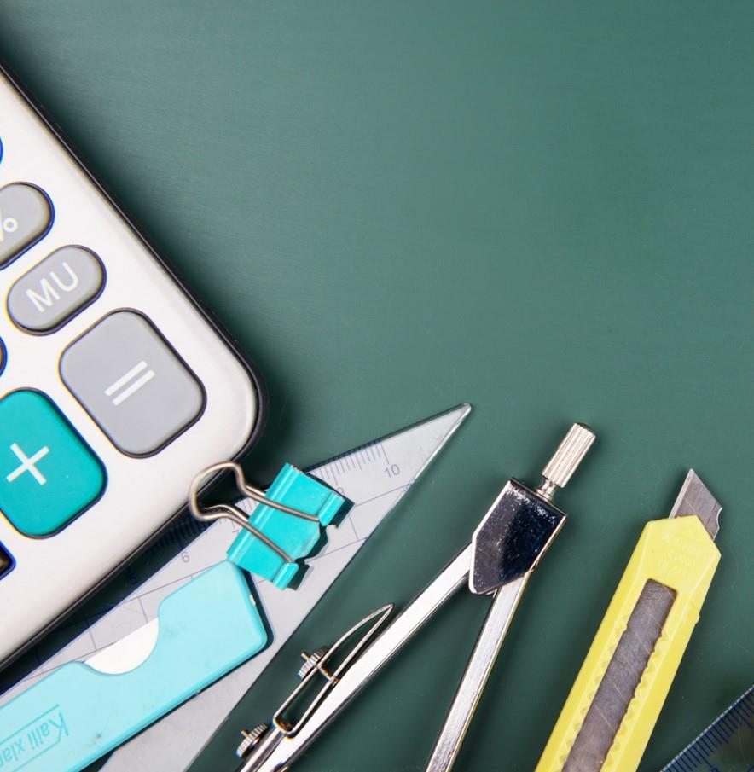
Introduction
This talk will cover the basic that you should have in your cover letter. What to do after you have written your cover letter and finally some examples of cover letters for you to look over for ideas.

Slide 3

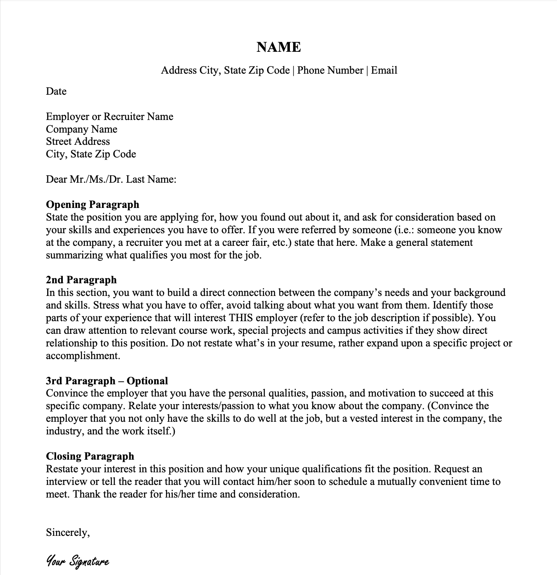



Slide 4



Basics in your letter
Header
Date
Greeting
Introduction
Emphasis of your skills
Conclusion
Sign off

Slide 5

Header

Slide 6

Date

Slide 7
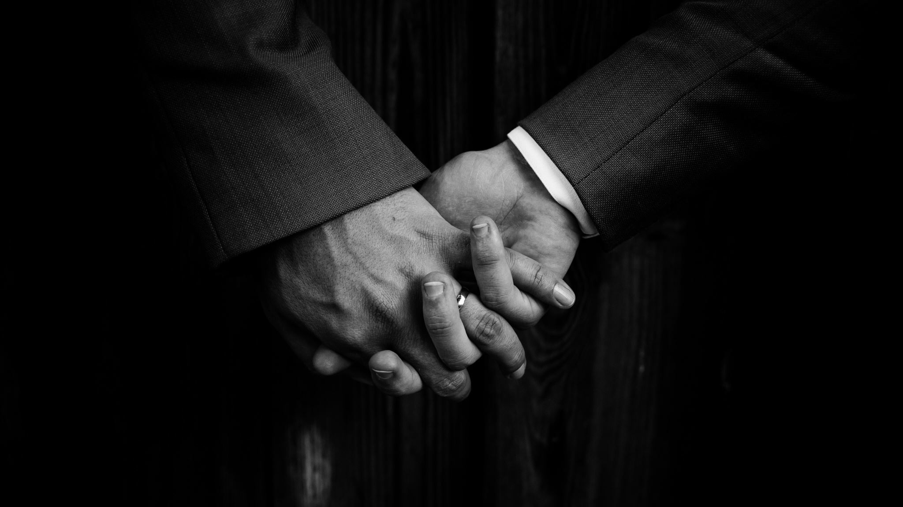
Greeting

Slide 8

Introduction

Slide 9

Emphasis your skills

Slide 10
Emphasis your skills
This is what will get you the job. Connect the dots for the recruiter!!
Match key word to your skill set
Highlight 2-3 key skills and experiences that directly relate to the job description, using specific examples and the STAR method (Situation, Task, Action, Result): Example: "In my previous role at [Company Name], I was responsible for [Task]. This resulted in [Result], demonstrating my ability to [Relevant Skill]."
Showcase your understanding of the company's work and why you're a good fit.
Address any potential concerns (e.g., career gaps) with concise explanations

Slide 11

Conclusion

Slide 12
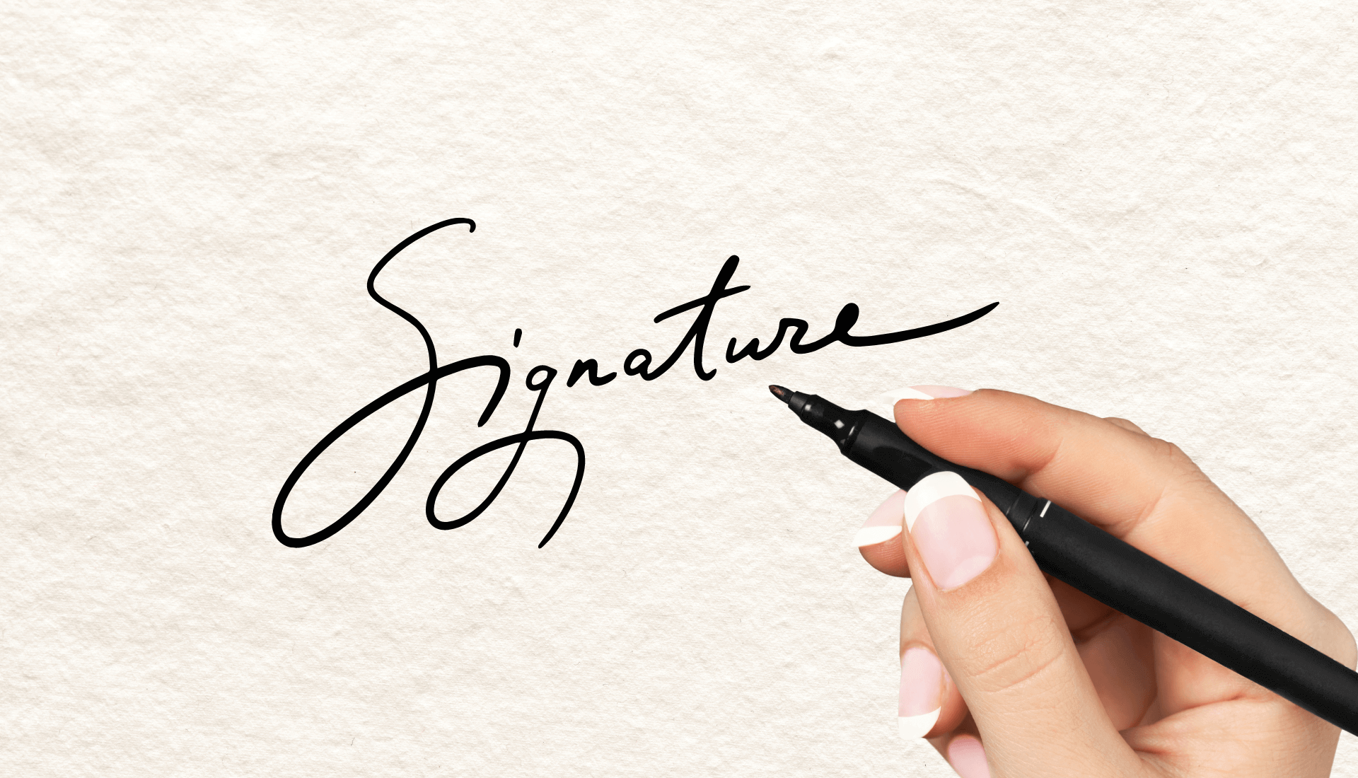
Sign Off

Slide 13
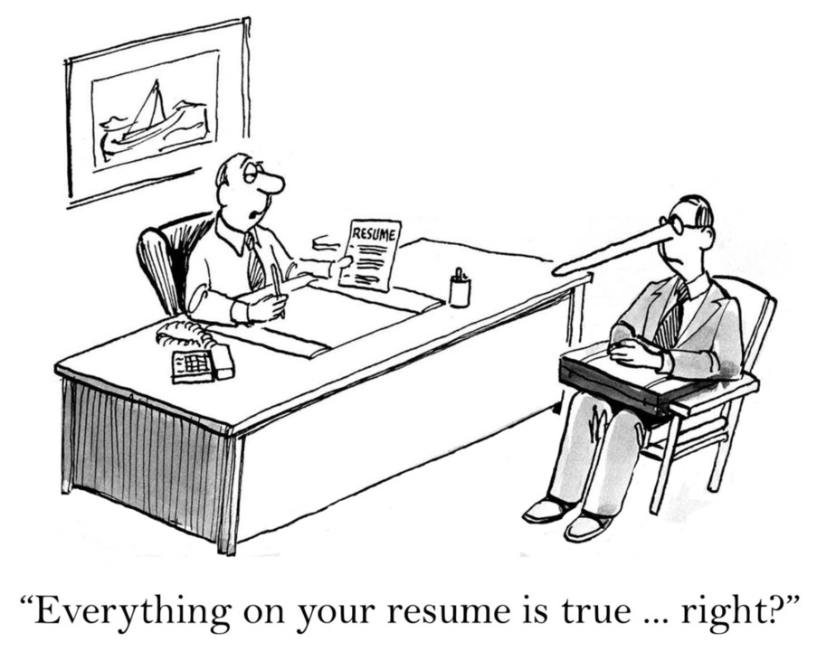
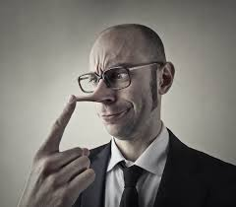
Never lie or exaggerate!!!

Slide 14
What you need to do after you wrote the letter
Proofread it
Check your facts
Keep your cover letter concise and to the point, typically one page in length.
Avoid jargon and be specific in your language.
Focus on your accomplishments and how they can benefit the company.
Tailor each cover letter to the specific job and company.
Don't simply repeat your resume; expand on your qualifications and provide context.

Slide 15
Timeline
Treat every letter as unique, do not reuse letters
Background
Find the key information about the position you are applying for.
Outline
Outline how your skills match with the key information in the job you are applying for.
Review your presentation
Look over this presentation to refreshen in your mind the main components in your letter.
Write the letter
Final Check
Just write the letter. It might take a few drafts, but plow through the first time to get it out on paper.
Look over the previous page’s slide and do your final check.

Slide 16
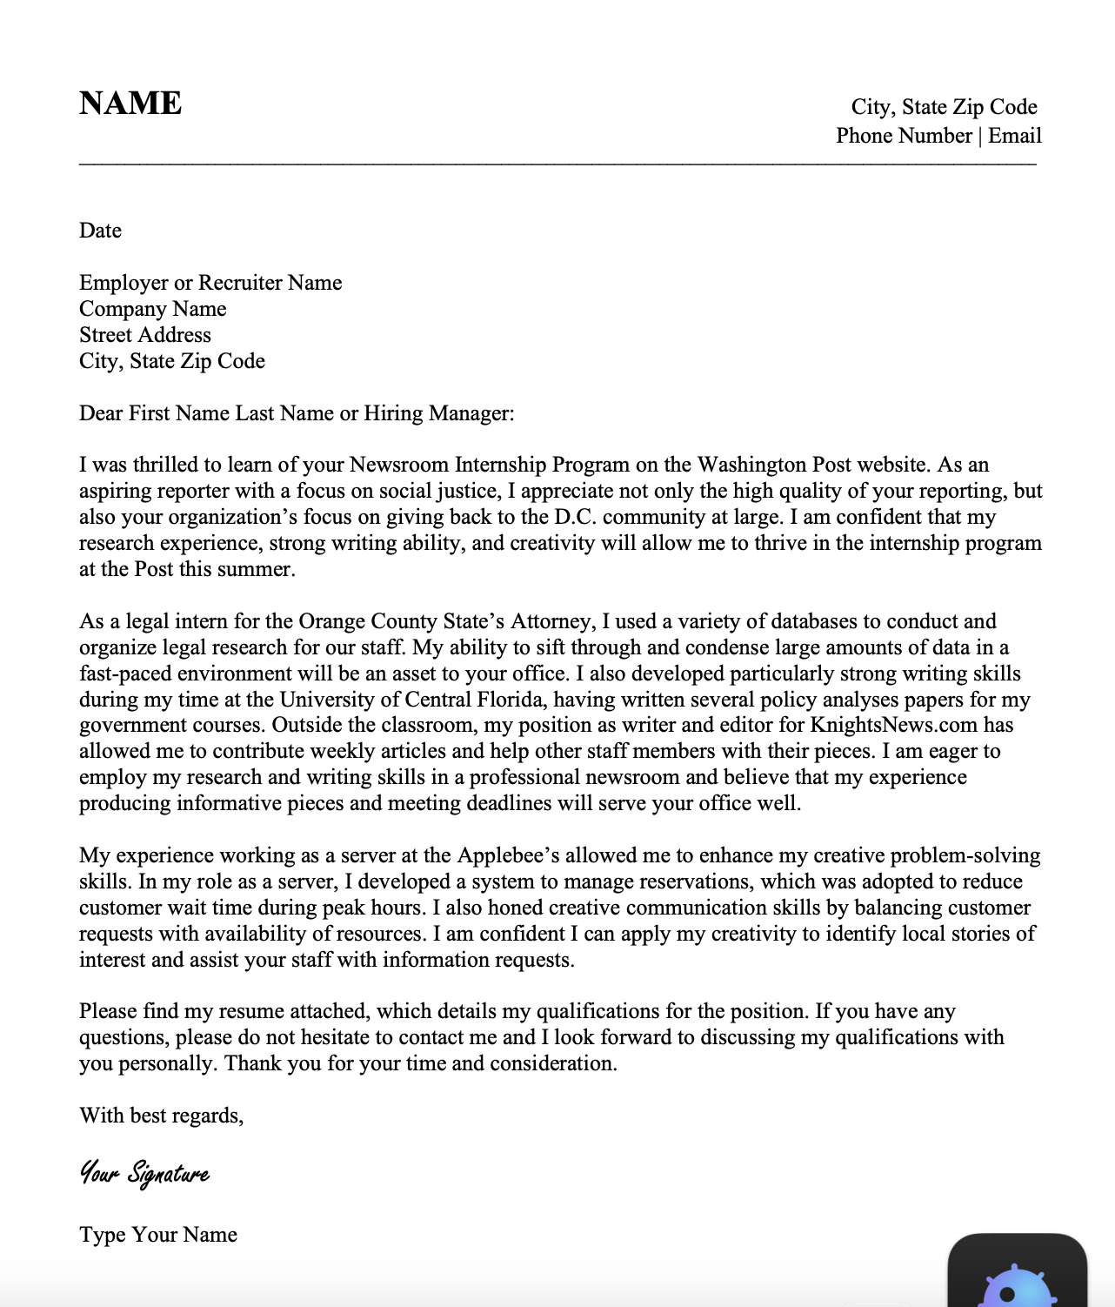

Slide 17
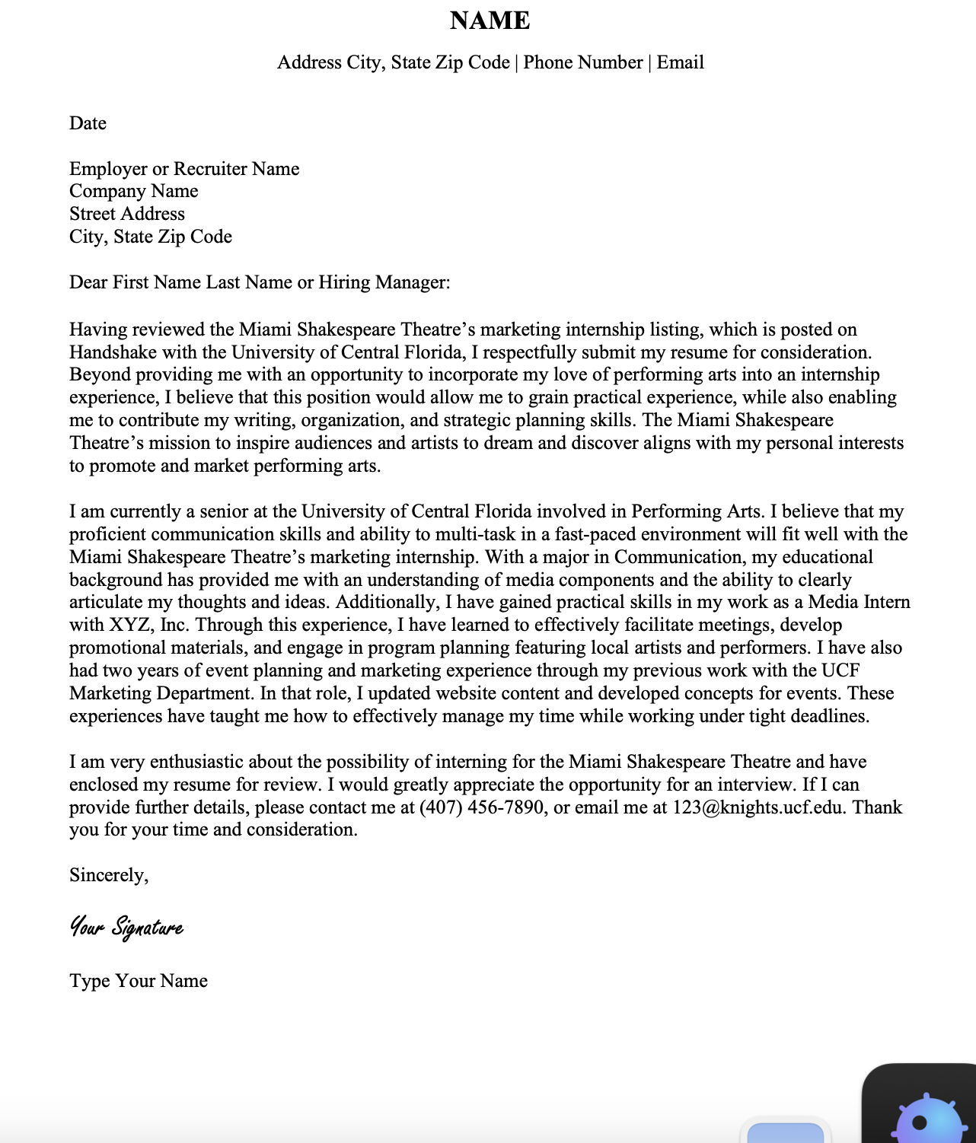

Slide 18
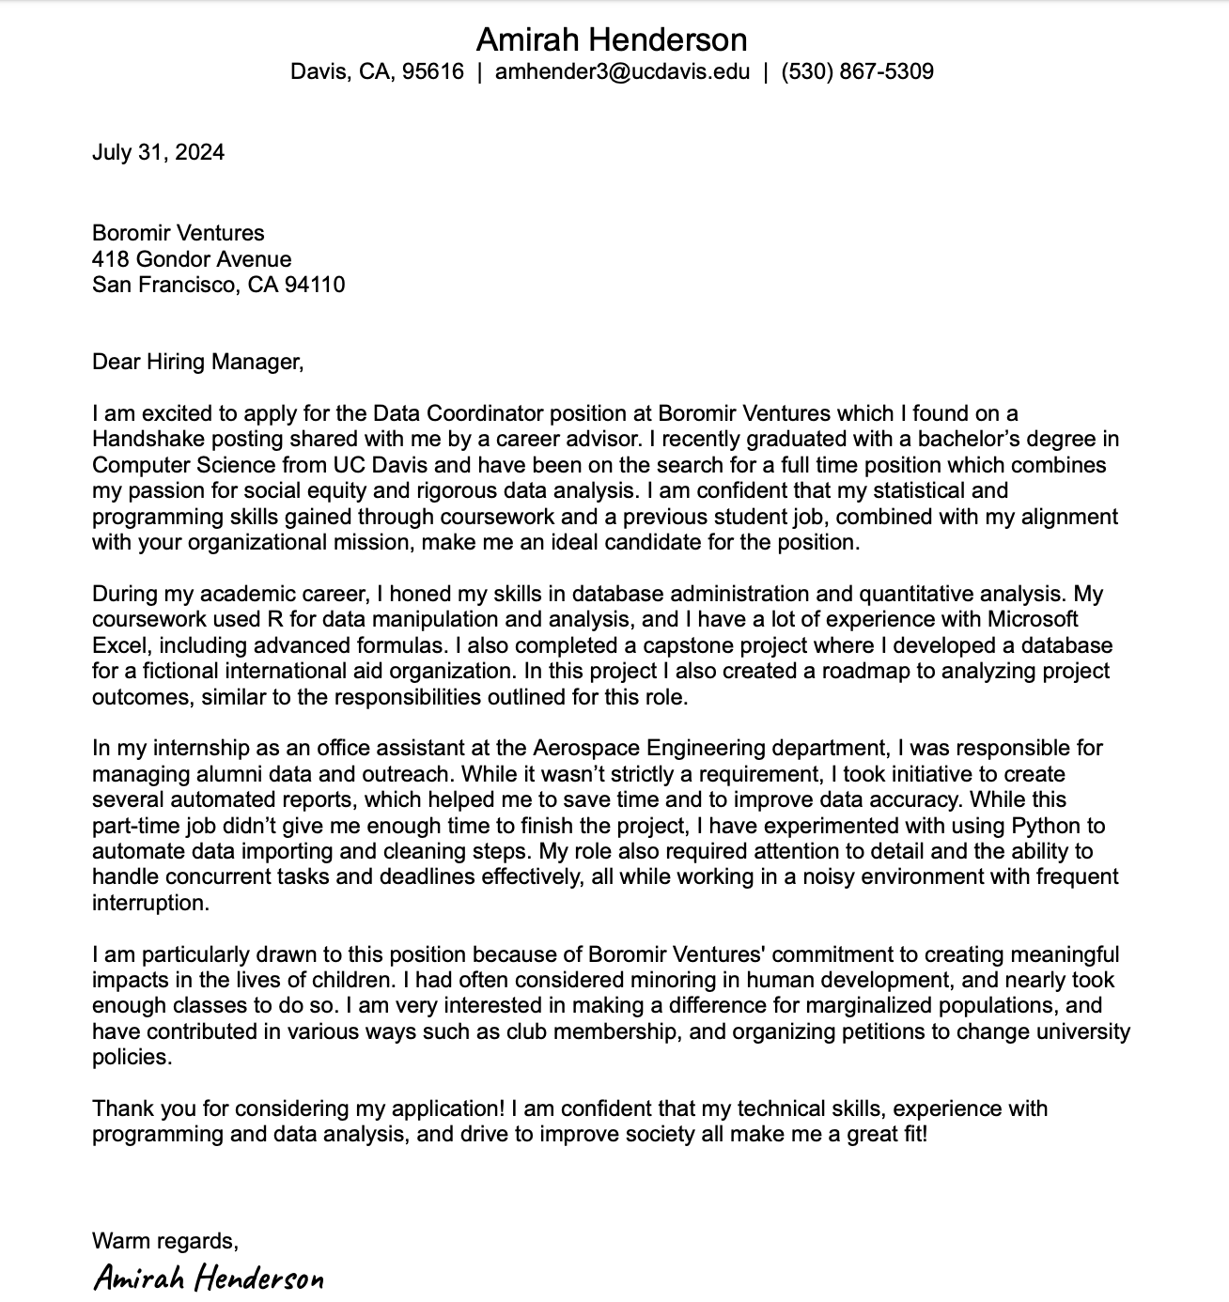

Slide 19


Thank you
Dr Paul E. Richardson
prichar@coastal.edu
https://professorrichardsonresearch.com/

