Slide 1
Resume Writing
Prof Paul E. Richardson
Summer Coastal Research Experience

Slide 2


Important points it must contain
1. Name and Contact Info

Slide 3

Important points it must contain
2. Summary Paragraph.

Slide 4

Important points it must contain
3. Employment History.

Slide 5

Important points it must contain
4. Skills.

Slide 6

Important points it must contain
5. Education.

Slide 7

Important points it must contain
6. Community Involvement (Optional)

Slide 8

Important points it must contain
7. Awards/Achievements You've Received

Slide 9
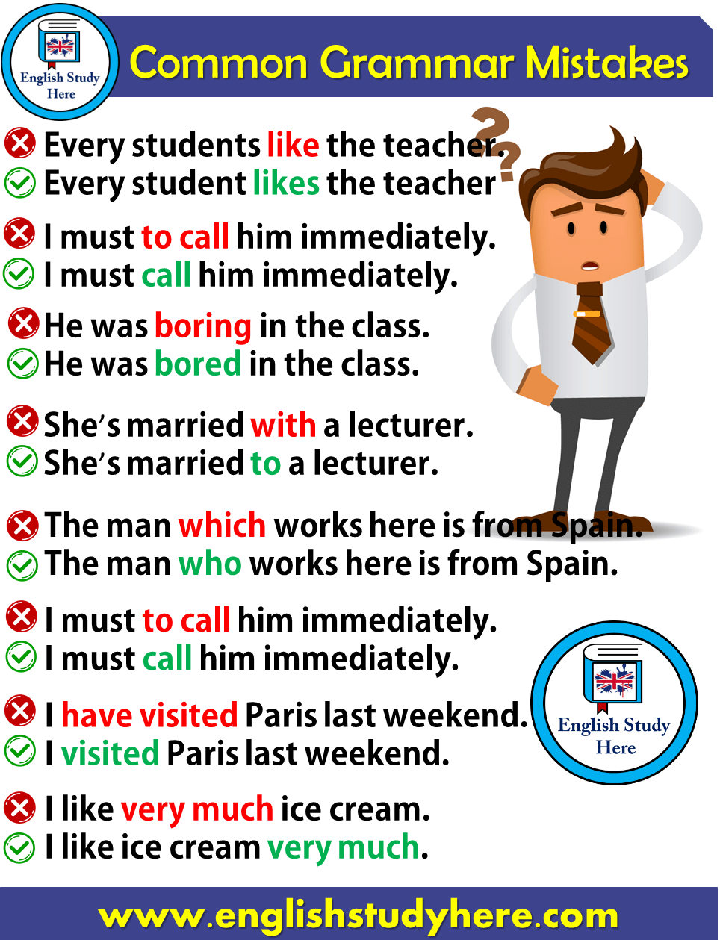
This you must avoid
1. Proofread your resume. No spelling or grammar errors!

Slide 10

This you must avoid
2. Lack of Specifics

Slide 11
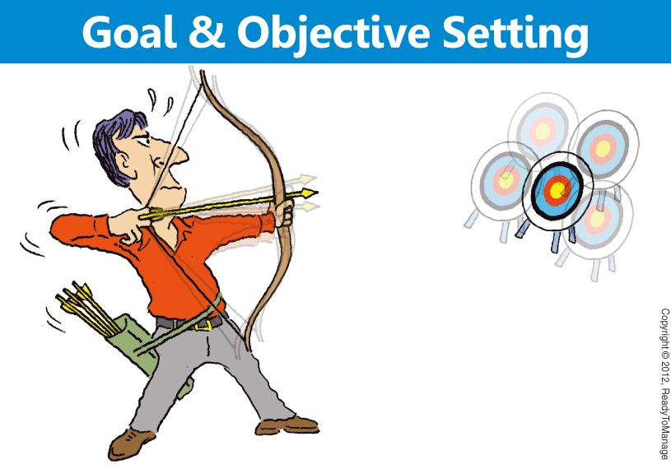
This you must avoid
3. Write it with a specific objective in mind

Slide 12


This you must avoid
4. Highlighting Duties Instead of Accomplishments

Slide 13

This you must avoid
6. No Action Verbs

Slide 14
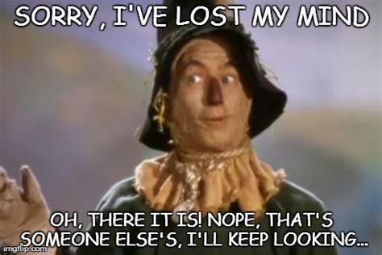
This you must avoid
7. Leaving Off Important Information

Slide 15

This you must avoid
8. Visually Too Busy

Slide 16
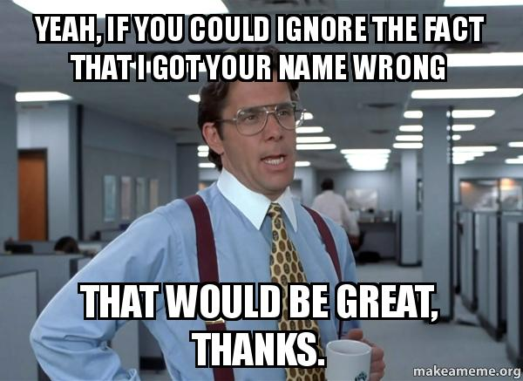
This you must avoid
9. Incorrect Contact Information

Slide 17

This you must avoid
10. No cover letter

Slide 18
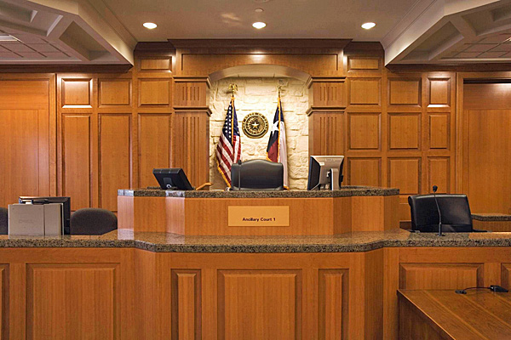
Things you must never do!
Never lie or make up information
Only put information on your resume that you could prove

Slide 19
Overall look
Not more than two pages, one is best
Not too busy
Not too dull
Want your resume to show effort!

Slide 20
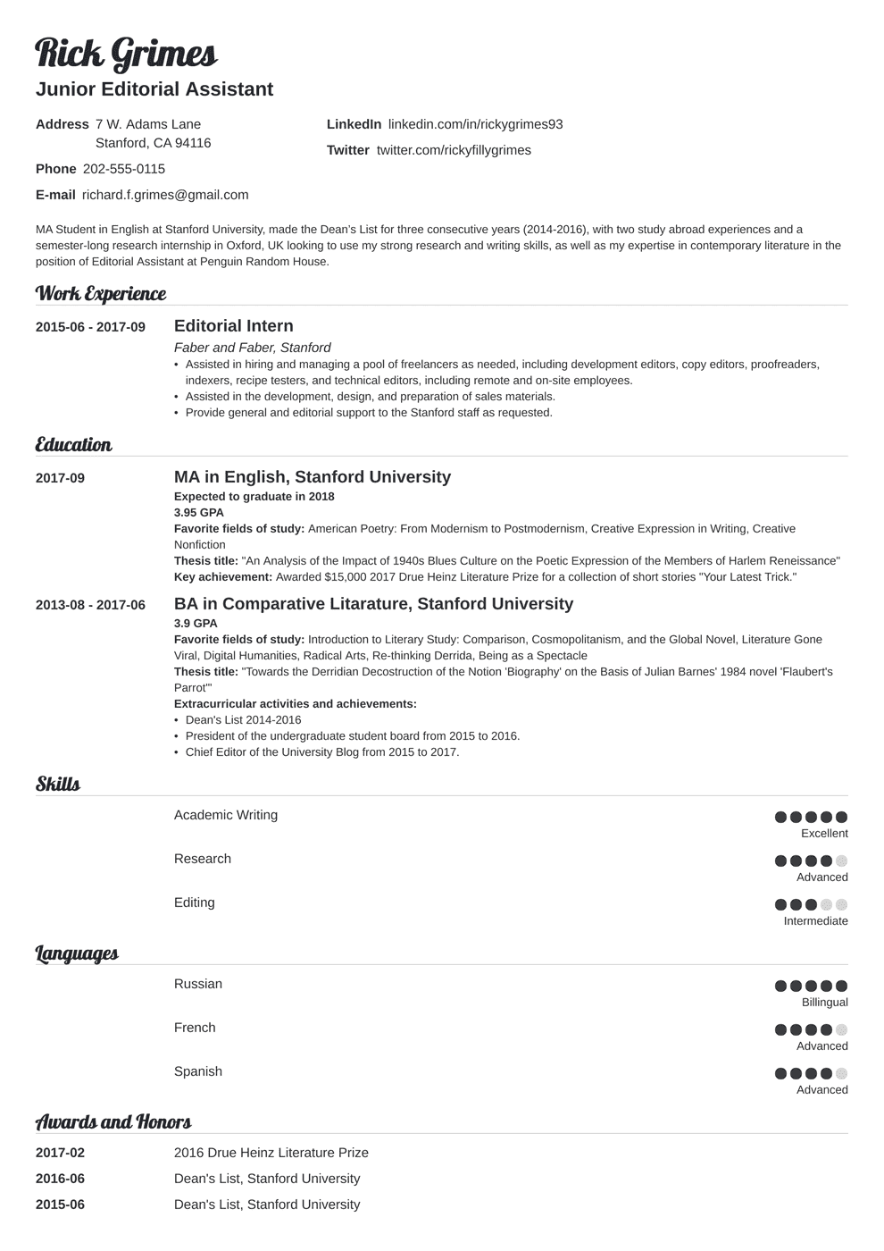
What is good?
What isn’t good?

Slide 21
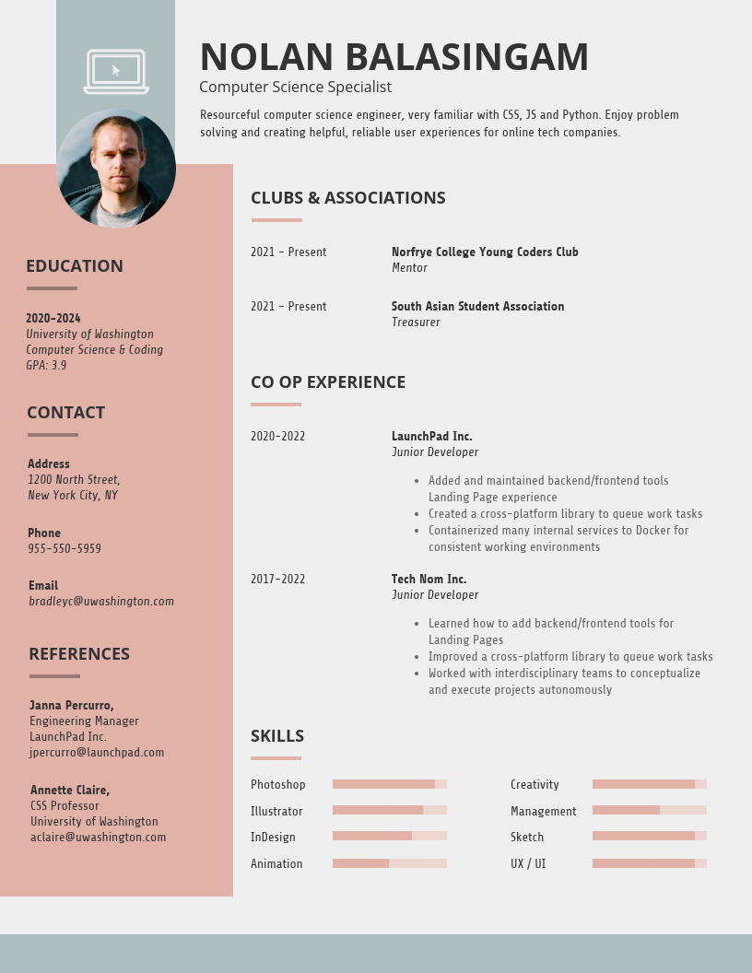
What is good?
What isn’t good?

Slide 22
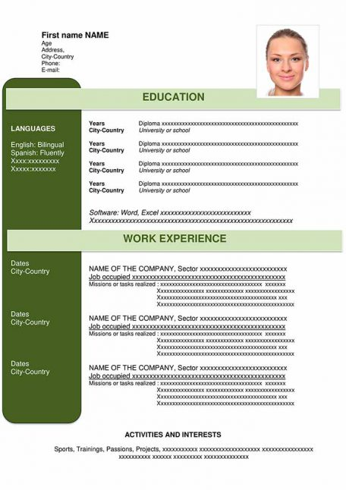
What is good?
What isn’t good?

Slide 23
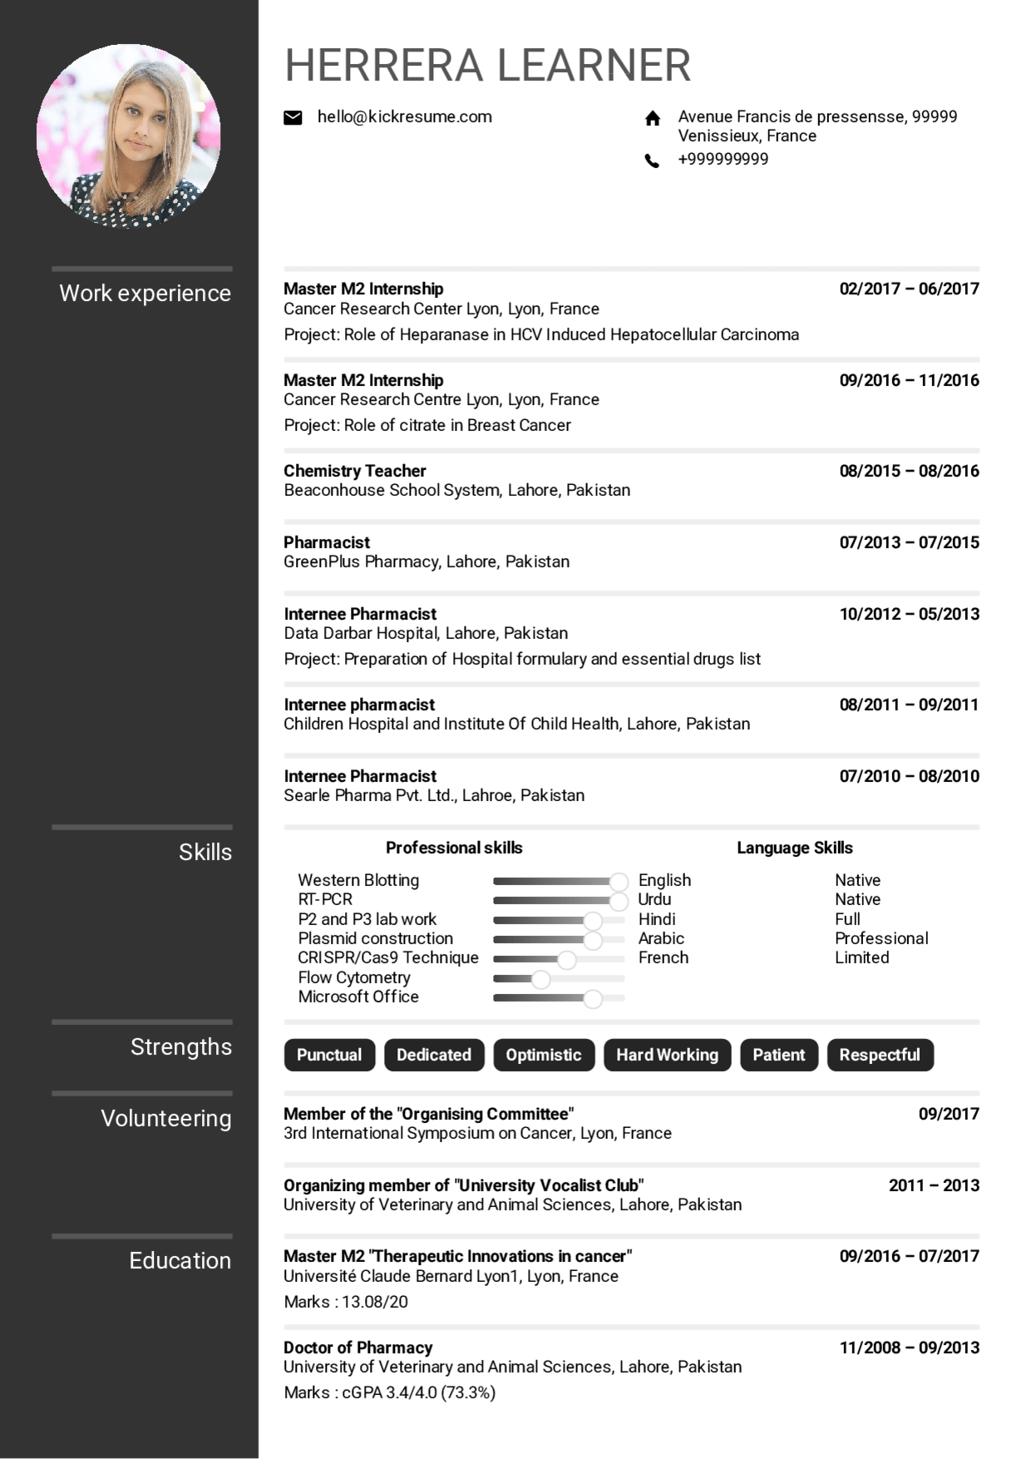

Slide 24
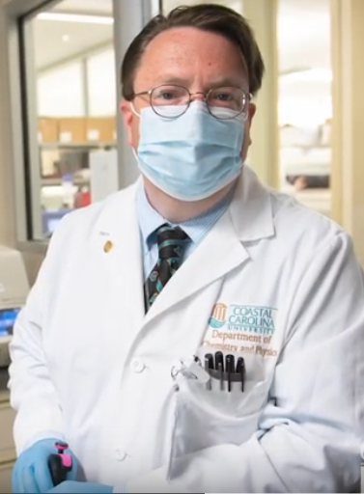
Question Time!
Prof Paul E. Richardson
prichar@coastal.edu
Email me if you want a copy of this ppt

