Slide 1
How to make an oral presentation
Prof Paul E. Richardson
Summer Coastal Research Experience

Slide 2
You will have to do an oral presentation soon!
August 10, 2017
2:00pm to 4:00pm
You need to be ready!

Slide 3

Top 10 fears
Speaking before a Group
Heights
Insects and bugs
Financial problems
Rejection
Sickness
Death
Flying
Loneliness
Failure

Slide 4

Your biggest fears
Say the wrong thing
Clarity of the presentation
Keeping the attention of the audience
Communicate with the audience
Nerves
Forgot to mention something
Smooth transitions
Ability to answer questions

Slide 5

Are you ready for your journey?

Slide 6

The journey of making a presentation
← You are here
You could be here

Slide 7
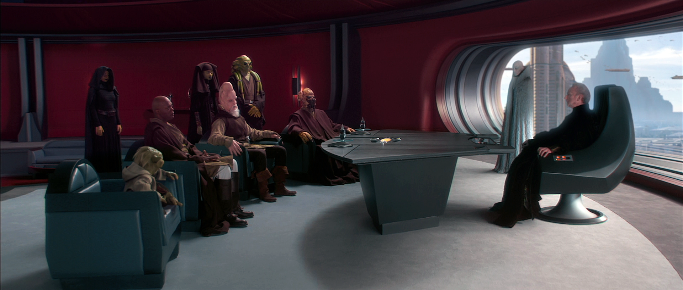
How can you turn from the dark side
“If you know the enemy and know yourself, you need not fear the result of a hundred battles. If you know yourself but not the enemy, for every victory gained you will also suffer a defeat. If you know neither the enemy nor yourself, you will succumb in every battle”
– Sun Tzu

Slide 8

How can you turn from the dark side
Planning prevents piss poor performance
- – Uncle Henry

Slide 9

What do you choose?
Understanding
Fear
Suffering
Planning

Slide 10
Understanding
Is there a difference between a poster presentation or oral presentation

Slide 11

Understanding
Is there a difference between a poster presentation and oral presentation?
Only the medium of the presentation is different

Slide 12

Understanding
You are telling a story

Slide 13

Telling your story
Storyboard your
presentation

Slide 14
Telling your story
Your Storyboard
Background
Question
Methods
Results
Conclusions

Slide 15

Telling your story: Background
Introduce your characters.
Explain the basic information about the topic.
Explain its relevance to your audience.
Introduce them to any vocabulary you might use and your audience doesn’t know.
Why is this important.

Slide 16

Telling your story: Question
What is the specific question you are addressing with this study
What is your hypothesis
This is the most important section
Must tie into the introduction

Slide 17

Telling your story: Methods
Do not spend too much time here
Least important section
Basic story of how you did things and why
Keep it simple and not too technical

Slide 18



Telling your story: Results
Spend time in this section
Should have a figure/table for each result
Use summary table(s) when you have lots of data
Should tie into some of the background
Tie it into the question your research proposed
Use your medium available
Really work this section and your vocabulary
This is the climax of the story

Slide 19

Telling your story: Conclusion
Summarize your results
Explain the meaning of your results
Answer your research question
What will the future hold

Slide 20


Planning
Do your story board first
Fill in all the parts
Practice, Practice, and Practice

Slide 21
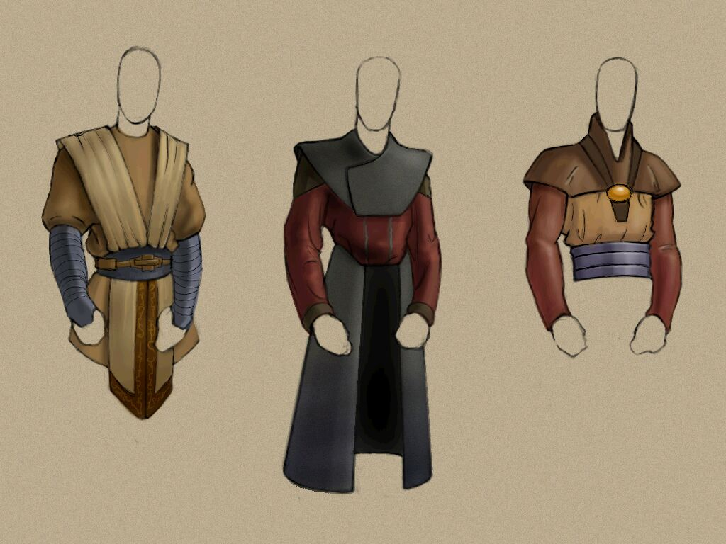
Tricks to help you succeed
Attire
Dress professional, dress to impress
Wear nothing that dangles or distracts
Business casual or Business is the way to dress
If your mom would smile with joy, then it is ok
How you look is more than just your clothes
Avoid heels unless you are very good at wearing them
Dress so you can move around the room

Slide 22

Tricks to help you succeed
Voice
Try to speak slowly, annunciate your words
Speak clearly, make sure it is not shaky
Speaking fast is a clue you don’t know what you are talking about
Make sure you use inflections in your voice to keep your audience awake
Speak loud enough so the back of the room can hear you
Talk to your audience, not down to them

Slide 23

Tricks to help you succeed
Body positioning
Try to stand straight up
Do not lean on anything
Watch your happy hands
  Do not put them in pockets
  Do not put them in pockets and play with things in your pockets
  Don’t use your hands too much or too little
Be confident and strong
Look at your audience
Look like you are excited and happy to give this talk
You will get nervous, so just accept it

Slide 24

Tricks to help you succeed
Questions
Answer what you know
Don’t guess on the answers
If forced to guess, clearly state “if I had to guess” then answer the question
You should say “I will will into it and get back to you” with all questions you can’t answer
Be positive and not combative

Slide 25

Tricks to help you succeed
General Tips
Most likely you know more about this topic than anyone else in the room
Don’t memorize a speech, write an outline and worry about concepts
Don’t bring a sheet of paper with you unless you have to have it
Learn how to break between slides
Include references
Engage your audience, don’t just lecture. Ask questions, tell a joke
Speak to your audience at the appropriate academic (knowledge) level
Know the vocabulary of your talk, not just the meaning, but how to say it
Pay attention to your time
Make sure the talk has a good flow and make sense.

Slide 26
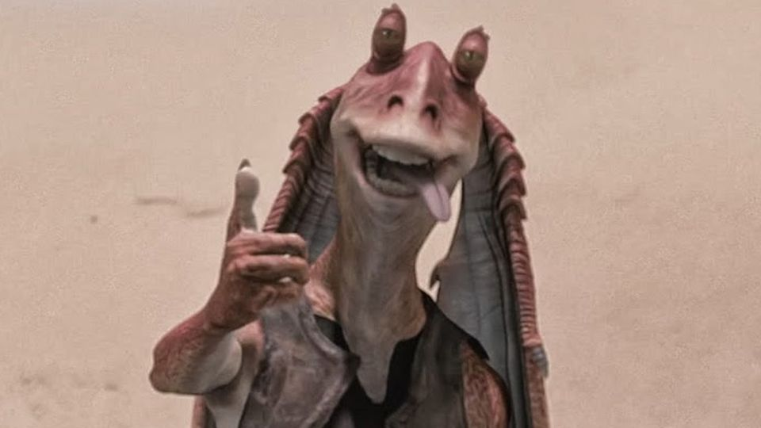
Tricks to help you succeed
Enthusiasm
If you can’t show enthusiasm for your research why would others?

Slide 27

Advice
Experience breeds success

Slide 28



First Conference

Slide 29

Your Questions

